Slide 1
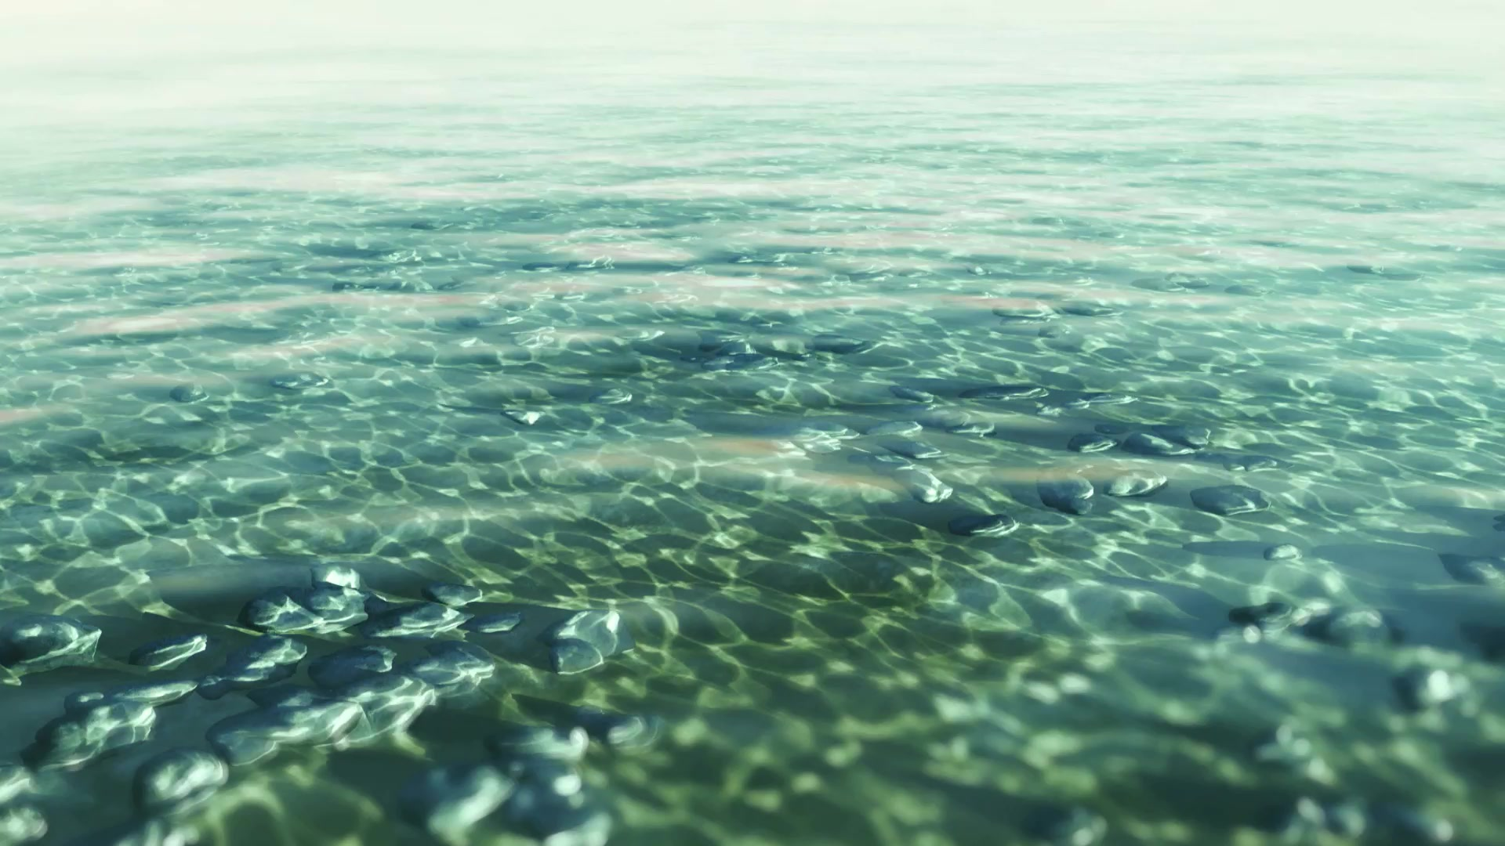
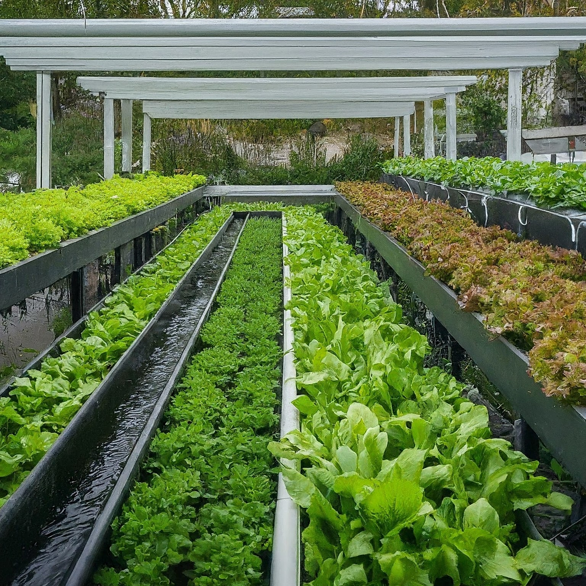
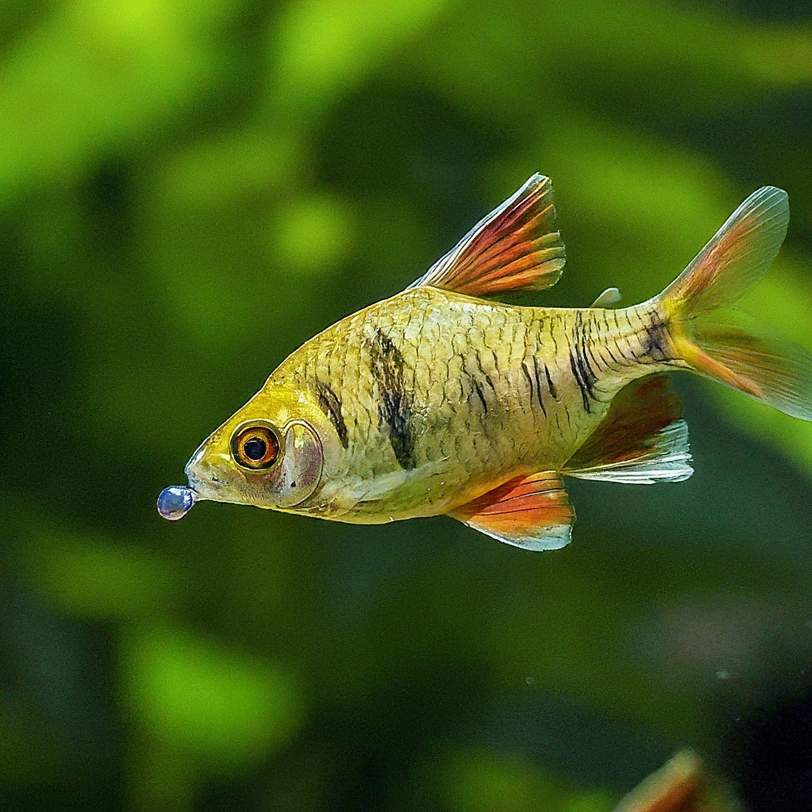
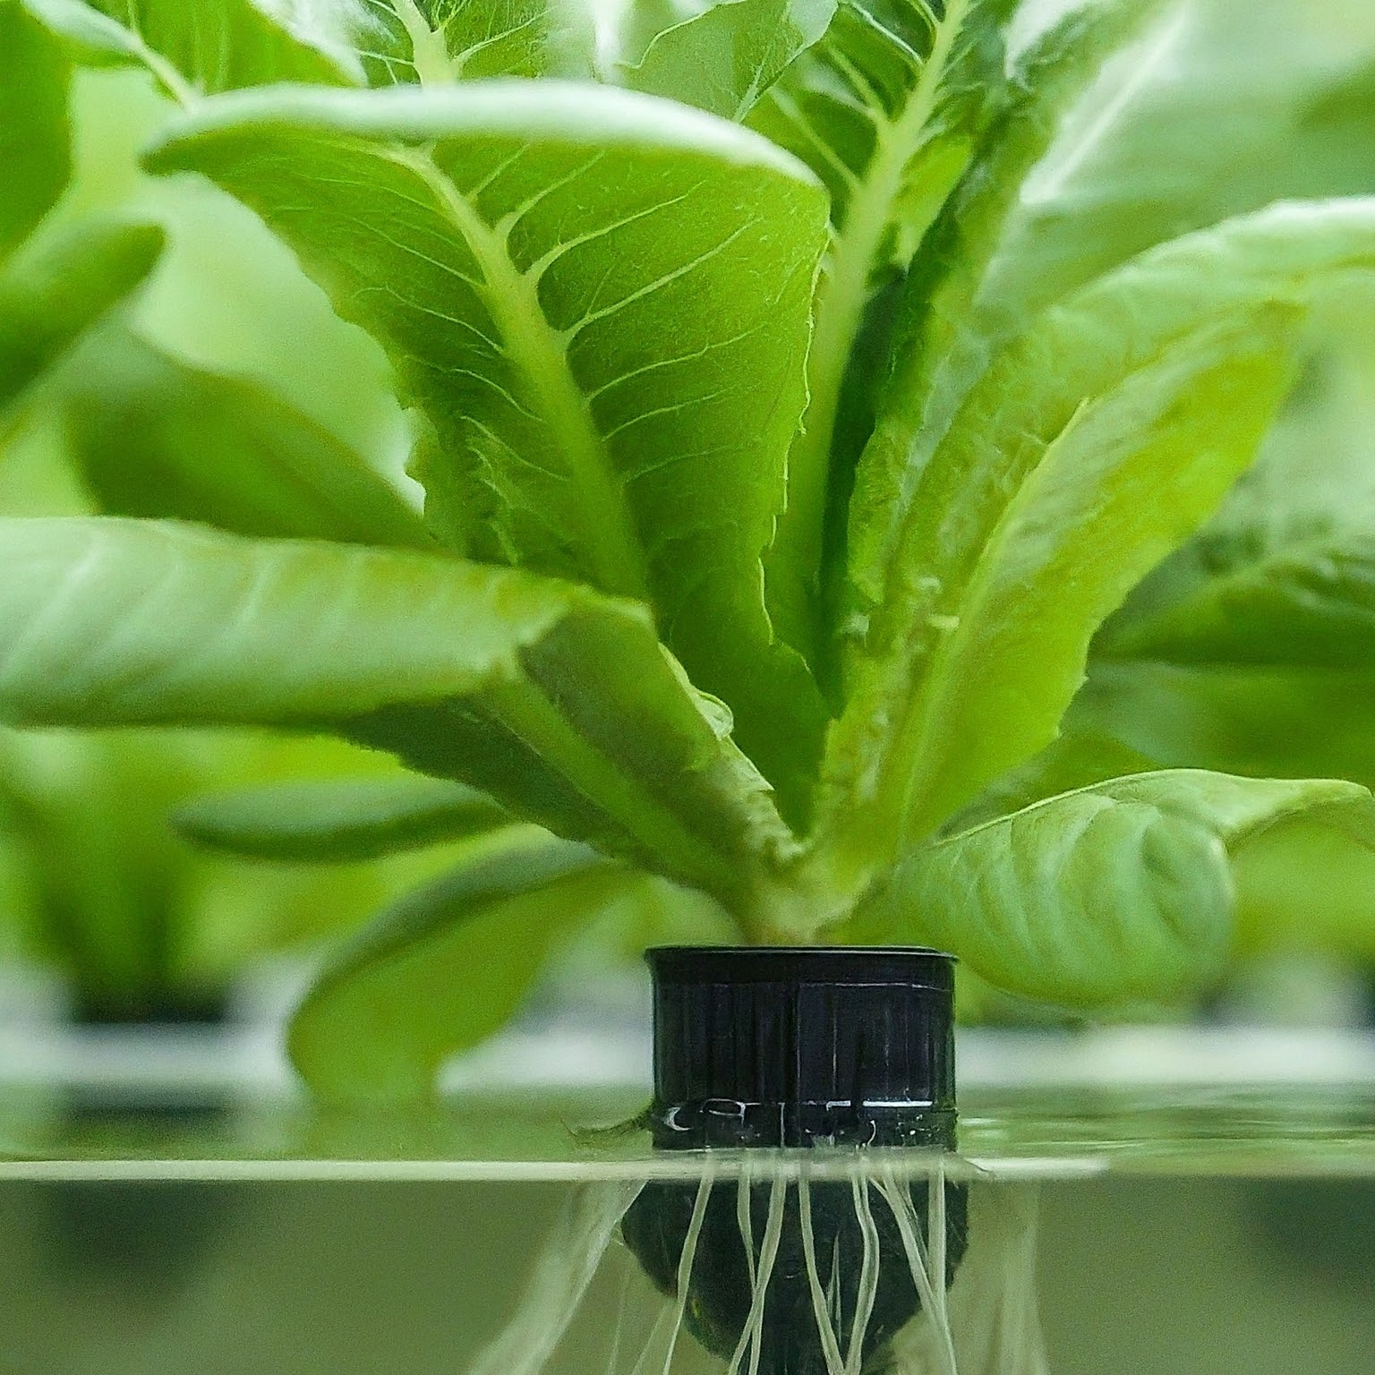
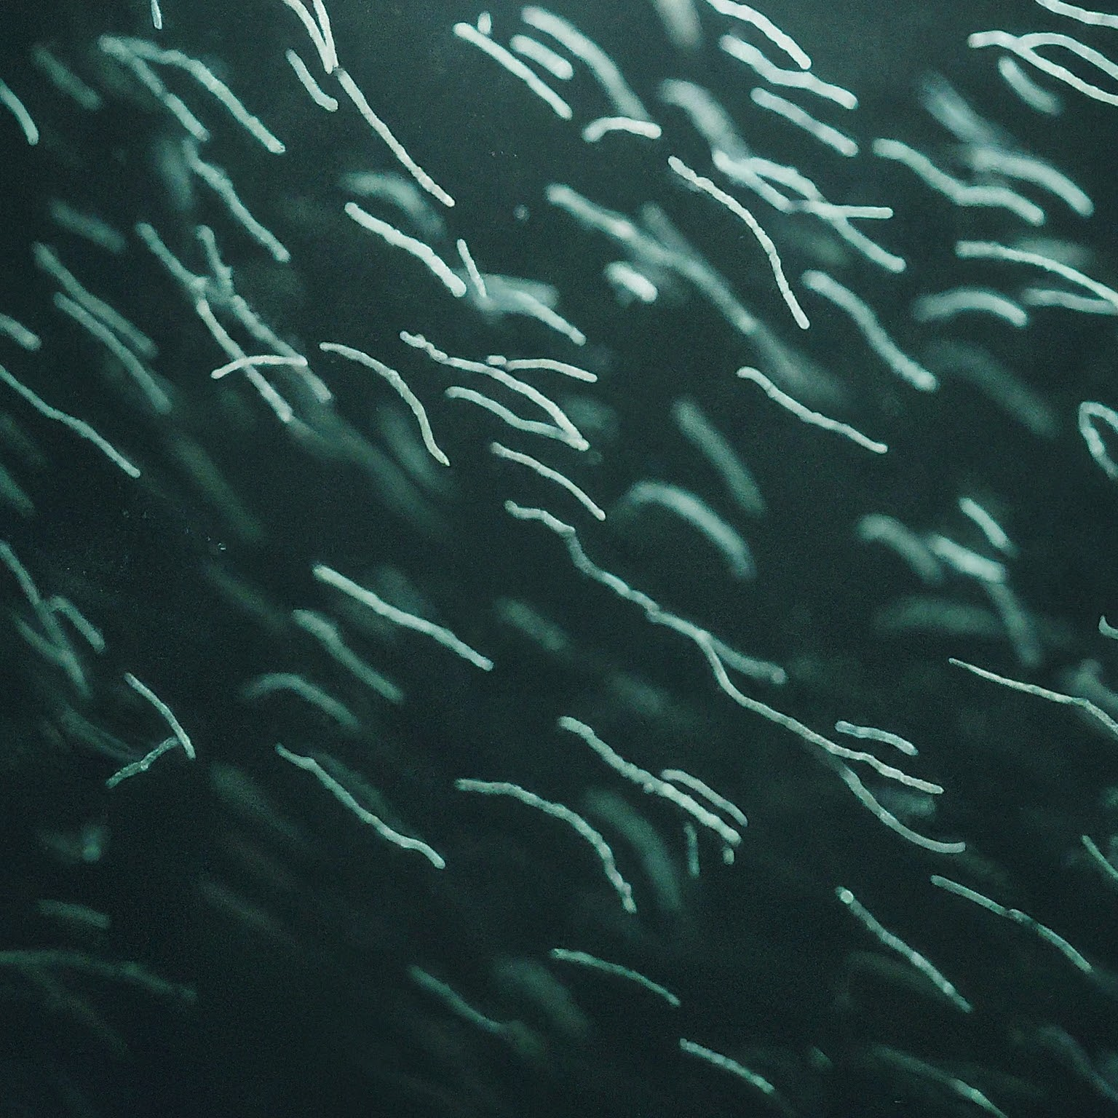
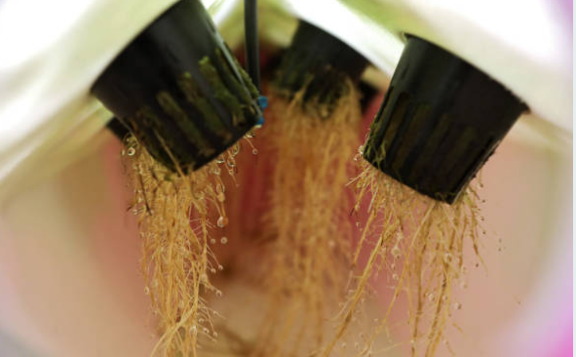
Unveiling the Sustainable Harmony of Aquaponics
Notes:
Good morning/afternoon everyone! Today, we embark on a journey into the fascinating world of aquaponics, a revolutionary method of growing food sustainably. Imagine raising fish and flourishing plants in tandem, utilizing a closed-loop system that benefits both. Buckle up as we explore the science, benefits, and practical steps to build your own aquaponic haven!

Slide 2

What is Aquaponics?
Marrying aquaculture (fish farming) and hydroponics (soilless plant cultivation)
Integrates fish waste (nutrients) for plant growth
Plants filter water, cleaning it for the fish
A sustainable, closed-loop ecosystem
Types of Aquaponics Systems
Media-based Systems: Plants root in gravel or other media
Raft Systems: Plants float on rafts in water
Deep Water Culture: Plants roots submerged in nutrient-rich water
Vertical Systems: Utilizes vertical space for space optimization
Notes:
Aquaponics isn't just two farming methods combined; it's a symbiotic partnership. Fish waste, rich in nutrients like ammonia, acts as a natural fertilizer for plants. These plants, in turn, act as biological filters, cleansing the water of harmful elements before it returns to the fish. It's a beautiful cycle of nature, replicated within a controlled system!

Slide 3
Aquaponics, Including the Nitrogen Cycle
Resource Efficient: Uses 90% less water than traditional farming
Sustainable: Minimizes waste and promotes closed-loop production, including the nitrogen cycle
Productive: Yields healthy fish and vegetables year-round
Local Food: Grows fresh produce in urban or arid environments
Pest and Disease Resistant: Soilless system minimizes pest and disease risks
Notes:
The nitrogen cycle is the foundation of a healthy aquaponics system. Fish excrete ammonia, a toxic substance for them. Luckily, helpful bacteria come to the rescue! They convert ammonia into nitrite, which is then further converted by other bacteria into nitrate. This nitrate is the magic ingredient for plants, providing them with essential nitrogen for growth. A small amount of nitrate is even converted back to ammonia, completing the continuous cycle. By maintaining this cycle, you ensure a thriving environment for both your fish and plants!

Slide 4
Key Players: Meet the bacterial heroes that make it happen:
Nitrosomonas and Nitrobacter: These nitrifying bacteria convert toxic ammonia from fish waste into nitrites and then nitrates, readily usable by plants.
Rhizobia (present in some plant root nodules): Establish a symbiotic relationship with specific plants, fixing atmospheric nitrogen into plant-available forms.
Heterotrophic Bacteria: Decompose organic matter, releasing ammonia back into the cycle for nitrification.
The Process:
Fish waste: Produces ammonia, harmful to fish in high concentrations.
Nitrosomonas: Converts ammonia to nitrites (NO2-), still slightly toxic.
Nitrobacter: Converts nitrites to nitrates (NO3-), readily absorbed by plants.
Plants: Utilize nitrates for growth, filtering the water.
Organic matter: Uneaten food and plant debris decompose, releasing ammonia through heterotrophic bacteria.
Importance:
Maintains water quality by removing harmful ammonia.
Provides essential nitrogen for plant growth.
Creates a balanced ecosystem within your aquaponics system.
Notes:
The magic of aquaponics lies partly in its ability to naturally manage nitrogen, an essential nutrient for plants. Fish waste, rich in ammonia (NH₄⁺), is the starting point. Here's how bacteria orchestrate this vital cycle. Aquaponics goes beyond simply combining fish and plants. It harnesses the power of natural processes like the nitrogen cycle. Bacteria play a starring role, converting fish waste into plant food, creating a sustainable loop. This not only benefits plant growth but also keeps the water clean for the fish. By understanding and maintaining this cycle, you can ensure your aquaponics system thrives!

Slide 5
Types of Aquaponics Systems
Media-based Systems: Plants root in gravel or other media
Raft Systems: Plants float on rafts in water
Deep Water Culture: Plants roots submerged in nutrient-rich water
Vertical Systems: Utilizes vertical space for space optimization
Notes:
Choosing the right system depends on your needs and resources. Media-based systems offer good filtration and support, while raft systems are simpler to set up. Deep water culture provides excellent nutrient access but requires strong pumps. Vertical systems are ideal for maximizing space, especially in urban settings. Explore your options and find the perfect fit!

Slide 6
Key Benefits of Aquaponics as Business
Resource Efficient: Uses 90% less water than traditional farming
Sustainable: Minimizes waste and promotes closed-loop production
Productive: Yields healthy fish and vegetables year-round
Local Food: Grows fresh produce in urban or arid environments
Pest and Disease Resistant: Soilless system minimizes pest and disease risks
Notes:
Aquaponics boasts an impressive list of benefits. Imagine saving water while growing more food! This method conserves precious resources, minimizes waste, and promotes a self-sustaining environment. You can enjoy fresh, locally grown fish and vegetables all year round, even in areas with limited land or water availability. And the bonus? Reduced risks of pests and diseases thanks to the soilless setup!

Slide 7
Choose your system type:
Media-based: Most popular for beginners, uses a grow bed filled with media (e.g., expanded clay) where plants grow and filter water.
Deep water culture (DWC): Plants suspended in nutrient-rich water with roots directly submerged. Requires good aeration and pump control.
Recirculating Aquaculture System (RAS): Focuses on optimizing fish health and uses aquaponics as a waste management solution. More complex.

Slide 8
Setting Up Your Own Aquaponics System
Choose your system: Decide on media type, fish species, and plant selection
Set up the tank: Install filtration, aeration, and water pump
Prepare the grow bed: Fill with appropriate media (if applicable)
Add fish and plants: Start with healthy specimens and monitor water quality
Maintain the system: Regularly test water parameters and adjust as needed
Notes:
Building your own aquaponics system can be a rewarding experience. Start by defining your vision - what fish and plants do you want to raise? Then, research and choose the system that best suits your needs. Setting up the tank and grow bed involves installing essential components like pumps and filters. Remember, healthy fish and plants are key, so carefully select your specimens and monitor water quality regularly. With dedication and attention, you can witness your own mini-ecosystem flourish!

Slide 9
Select your components:
Fish tank: Food-grade plastic or glass, size depends on chosen fish and desired plant yield.
Grow bed: Container for media or DWC system, needs drainage and water return.
Water pump: Circulates water between tank and grow bed (choose proper flow rate).
Air pump (optional): Oxygenates fish tank water (especially important for DWC).
Media (if using): Provides support and surface area for beneficial bacteria.
Tubing and fittings: Connect all components.
Lighting (optional): May be needed for some plants depending on sunlight access.

Slide 10
Plan your fish and plants:
Fish: Choose fish suitable for aquaponics (e.g., tilapia, koi) and stock tank responsibly.
Plants: Select varieties compatible with fish species and system type (e.g., leafy greens, herbs). Consider nutrient requirements and growth cycles.

Slide 11
Set up and cycle your system:
Follow safe fishkeeping practices for tank setup and water conditioning.
Cycle the system with fish-less ammonia source to establish beneficial bacteria before adding fish.
Monitor water quality parameters (pH, ammonia, nitrites, nitrates) regularly.

Slide 12
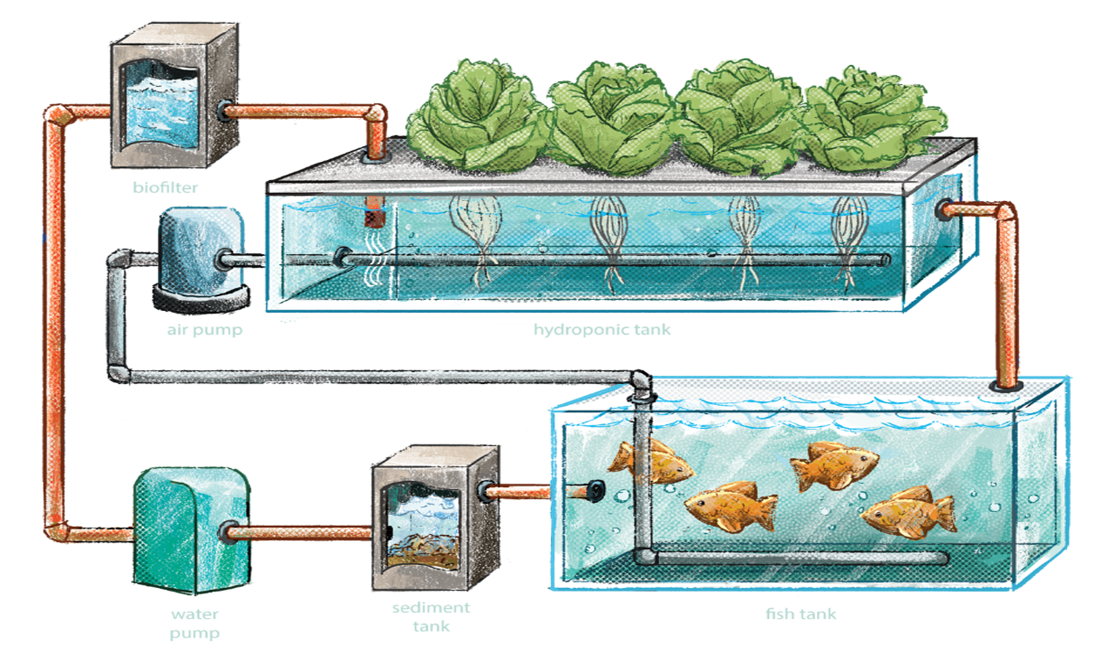

Slide 13
Resources and Further Exploration
The Aquaponics Association: https://aquaponicsassociation.org/
Nelson and Pade Aquaculture: https://aquaponics.com/aquaponic-systems/
Backyard Aquaponics: https://www.youtube.com/watch?v=T15gXm6ha_I
Local aquaponics groups and workshops

